Slide 1
Natural Language Processing
Unit 3
Faizan Javed
DataScience @ SMU

Slide 2
Trade-offs in various approaches to NLP
Shallow vs Deep
Statistical vs Symbolic
Feature Engineering vs Feature Learning
Top-down vs Bottom-up
Transparent vs Opaque (AI vs XAI)

Slide 3
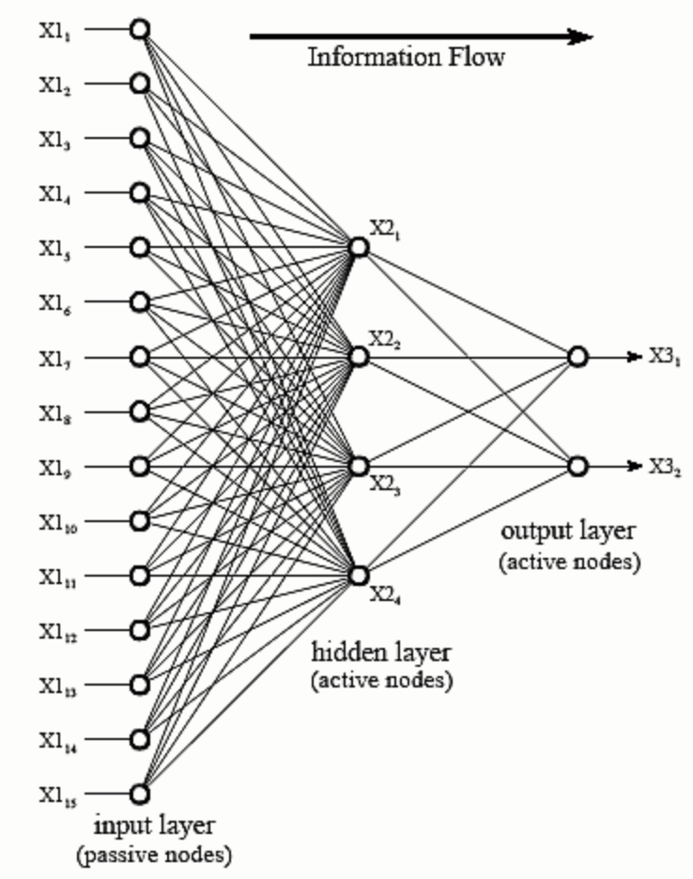
Shallow vs Deep NLP
Shall I build a very robust, exhaustive representation of text meaning, or shall I just pick out a few elements needed for my application?
Machine Learning Definition: layers in neural networks or Deep Belief networks
Each layer has one or more nodes
Information flows in one direction only (in this architecture)
Hidden layers modify inputs (according to some function)
Number of layers depends on complexity of task

Slide 4
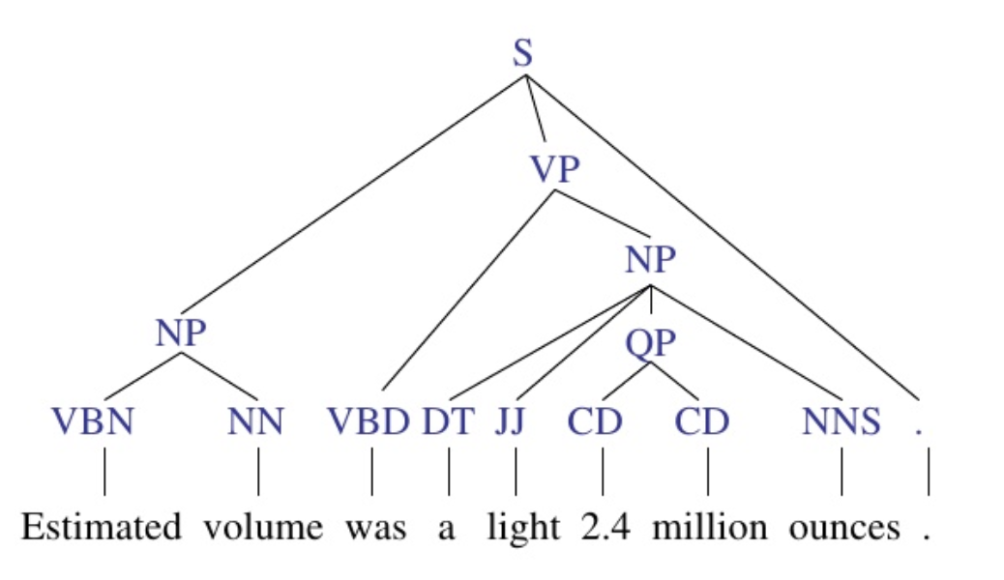
Shallow vs Deep NLP
Syntax parsers:
“Chunking”: classifying and labeling POS tags at the major levels (N, V, Adj, Adv) – does not extend to the most granular level of parsing (e.g., noun (N) can be further subdivided into categories like singular nouns (NN), singular proper nouns(NNP), and plural nouns (NNS))
Deep parsing: extends parsing to the most granular level
Example: which node level is chunking vs deep?

Slide 5
Shallow vs Deep NLP- Semantic Parsing
Shallow semantic parsers: semantic types (e.g., location, org, person), semantic roles (e.g., agents, theme), sense distinctions (e.g., WordNet, OntoNotes), entity resolution
Applications such as Question Answering, Machine Translation need deeper semantics:
e.g., might be useful to know the class a noun in a sentence belongs to, e.g. Tim is a football player, and a quarterback
Or, relations between concepts (stabbing is a kind of hurting) (parsing the phrase “Tim touchdown pass”)
Notes:
Beyond shallow semantics: https://noon99jaki.github.io/unpublished/2011.semantics.pdf

Slide 6
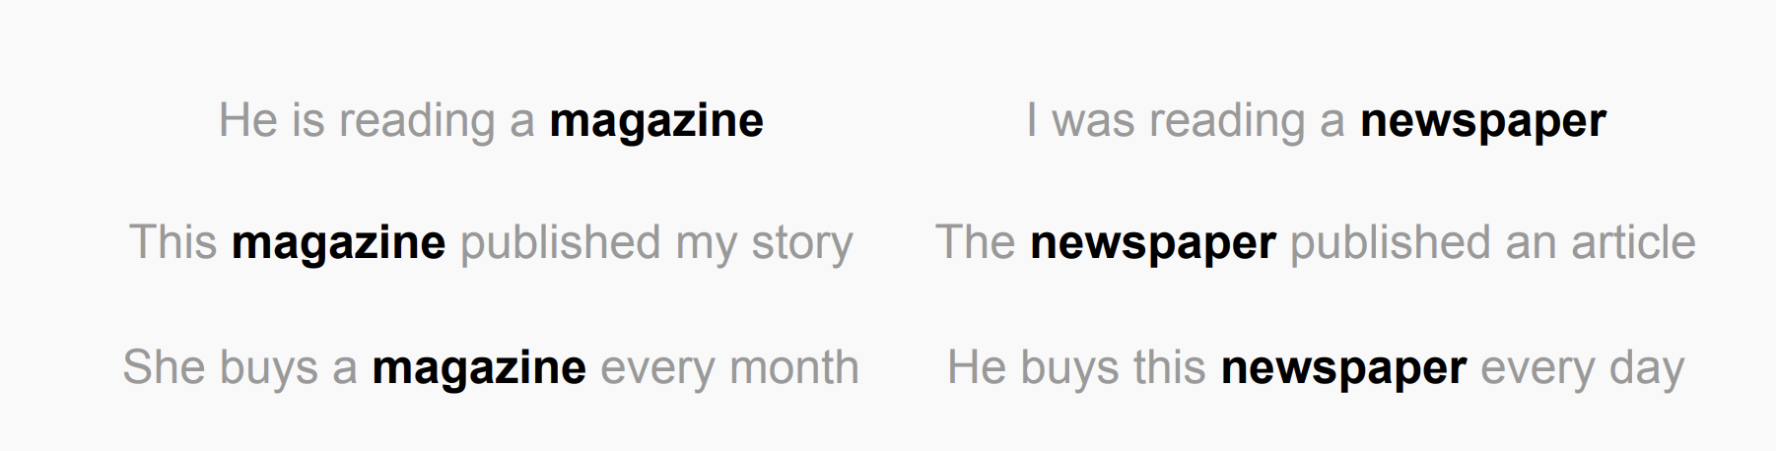
Shallow vs Deep NLP- word embeddings
Notes:
Beyond shallow semantics: https://noon99jaki.github.io/unpublished/2011.semantics.pdf
Contextual Word Representations: A Contextual Introduction
https://arxiv.org/pdf/1902.06006.pdf

Slide 7
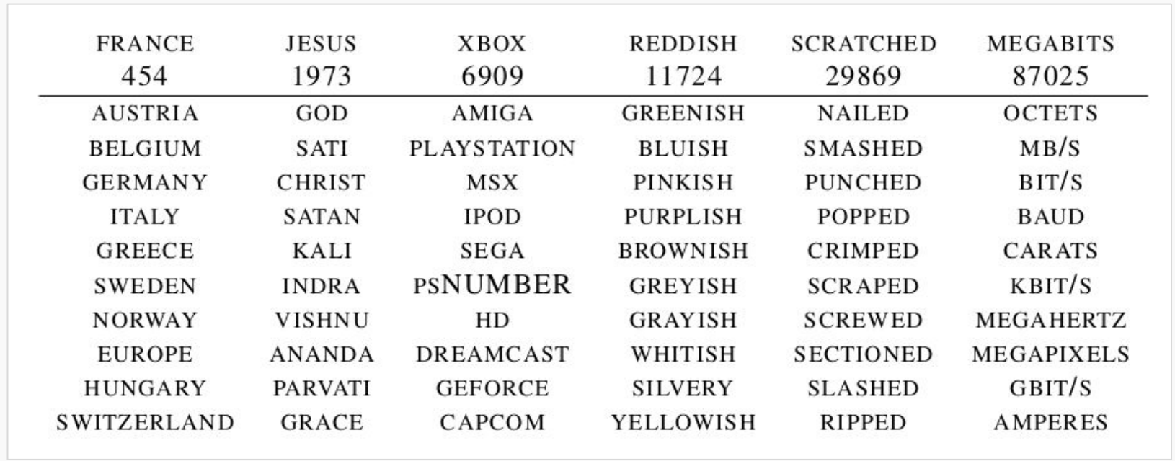
Shallow vs Deep NLP- word embeddings
Notes:
Beyond shallow semantics: https://noon99jaki.github.io/unpublished/2011.semantics.pdf
Contextual Word Representations: A Contextual Introduction
https://arxiv.org/pdf/1902.06006.pdf

Slide 8
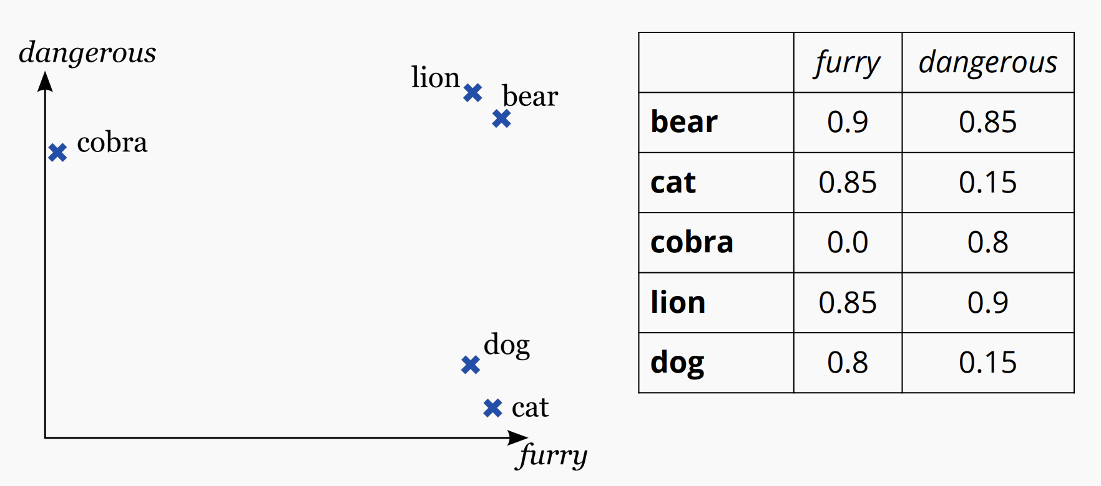
Shallow vs Deep NLP- word embeddings
Notes:
Beyond shallow semantics: https://noon99jaki.github.io/unpublished/2011.semantics.pdf
Contextual Word Representations: A Contextual Introduction
https://arxiv.org/pdf/1902.06006.pdf

Slide 9
Shallow vs Deep NLP- word embeddings
Context-free embeddings: Word2Vec, Glove, et al
Combine all the senses of a word into one
“He went to the prison cell with his cell phone to extract blood cell samples from inmates” – all senses of the word cell will be combined into one vector
Contextual-embeddings: Elmo, BERT, et al
Generate different embeddings for a word depending on the context/position in a sentence
“He went to the prison cell with his cell phone to extract blood cell samples from inmates”
The first “cell” (prison) would be closer to words like incarceration, crime, the second “cell” (phone case) would be closer to words like iphone, android, galaxy, third ”cell” (blood) would be closer to platelets, vein, arteries, etc.
Notes:
Beyond shallow semantics: https://noon99jaki.github.io/unpublished/2011.semantics.pdf

Slide 10
Shallow vs Deep NLP – Machine learning context
Wide and Deep Learning - https://ai.googleblog.com/2016/06/wide-deep-learning-better-together-with.html
Memorization and Generalization, Linear models and Deep Models
E.g,: FoodIO app – just say what kind of food you want, and the app will predict the dish the you will like best
First cut (non-ML version?)
Wide component: a linear model that captures how the co-occurrence of a query-item feature pair correlates with the target label (whether an item is consumed or not)
Deep component: user need: similar but different cuisines (discovery): generalize by matching items to queries that are close to each other in the embedding space
Balance between the two depends on intent: “iced decaf latte with nonfat milk” vs “seafood”

Slide 11
Feature Engineering and Feature Learning
Shall I involve human experts to engineer features,
or shall I use them only to establish a training set?
Feature Engineering:
the process of using domain knowledge to extract ”hand crafted” features from raw data via data mining techniques. These features can be used to improve the performance of machine learning algorithms.
Feature Learning:
set of techniques that allows a system to automatically discover the representations needed for feature detection or classification from raw data.
This replaces manual feature engineering and allows a machine to both learn the features and use them to perform a specific task.

Slide 12
Feature Engineering and Feature Learning
Example: Cat vs Dog image classifier
What should be the input to the classifier?
Option 1: use raw pixels as features – but it’s a massive feature space that makes it hard for models to generalize! (what is the text equivalent?)
Option 2-a:
Manually define and extract features using domain knowledge. Examples: edge detection, corner detection, histograms, etc. However, these may not be the best possible features for this problem.
Option 2-b:
Train a model to identify and extract features
(e.g., deep learning CNNs)
These arent general low-level features like edges or corners,
but are tailored for each class.
We have no control on what
features will be extracted
Notes:
https://blog.featurelabs.com/feature-engineering-vs-feature-selection/

Slide 13
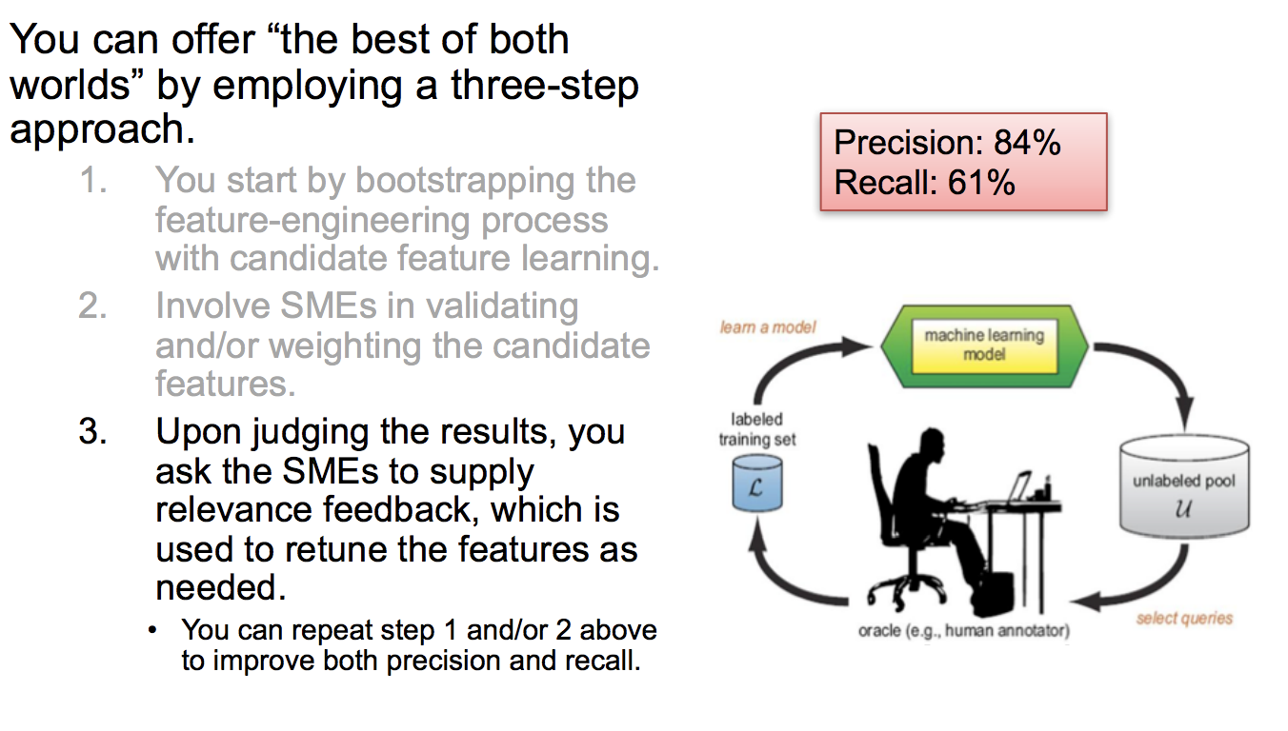
Feature Engineering and Feature Learning
Notes:
https://blog.featurelabs.com/feature-engineering-vs-feature-selection/

Slide 14
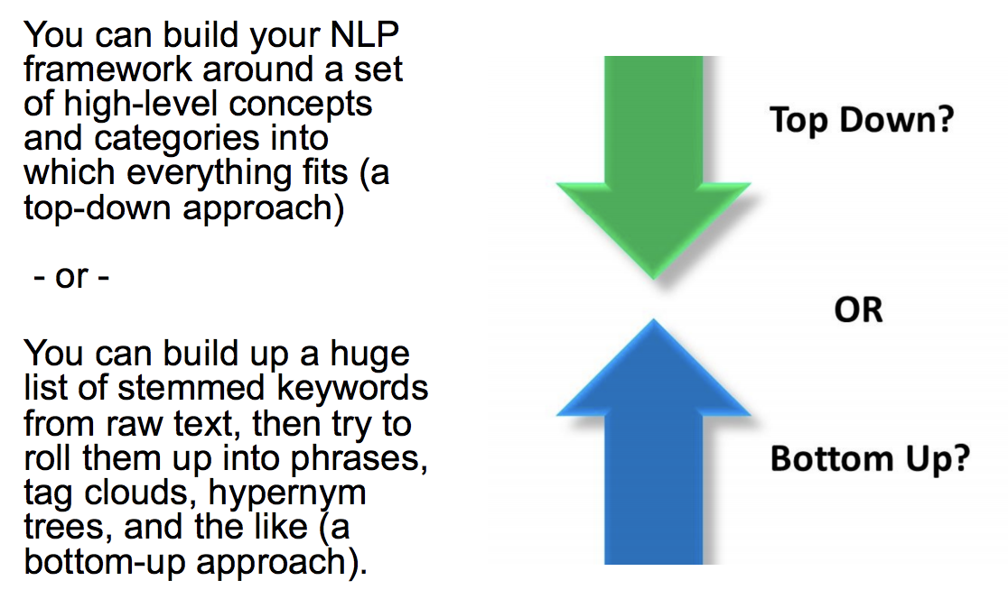
Top down vs Bottom up NLP
Shall I start a with high-level classifications and text characteristics, then gradually break them down into more detail, or shall I do the reverse?

Slide 15
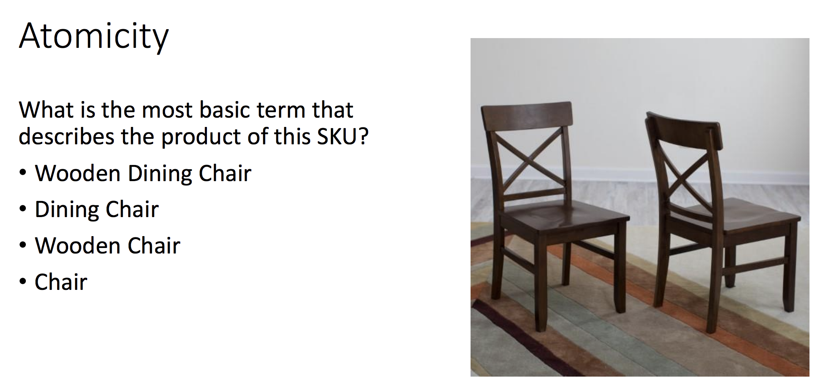
Top down vs Bottom up NLP

Slide 16
Top down vs Bottom up NLP
Middle-ontology: what level of fine grained-ness is appropriate for leaf level nodes?
Hey, look at what that dog is doing?
Hey, look at what that standard smooth-haired dachshund is doing?
Cordless High-Torque Impact Wrench w/Free M18 4.0Ah Extended Capacity Battery
6-1/2 in. 48-Teeth Carbide Tipped Saw Blade for Circular Saw
22 in. x 48 in. Original Drywall T-Square
Entities? Attributes?

Slide 17
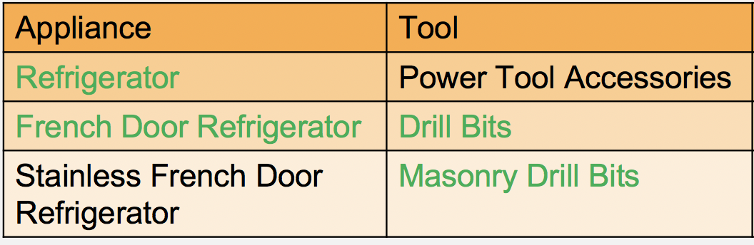
Top down vs Bottom up NLP
Leaf level node: semantic tag for an entity that uniquely identifies what it is.
Least number of words (<5) that a domain expert can understand and serve their use case.
Can you combine the two approaches?

Slide 18
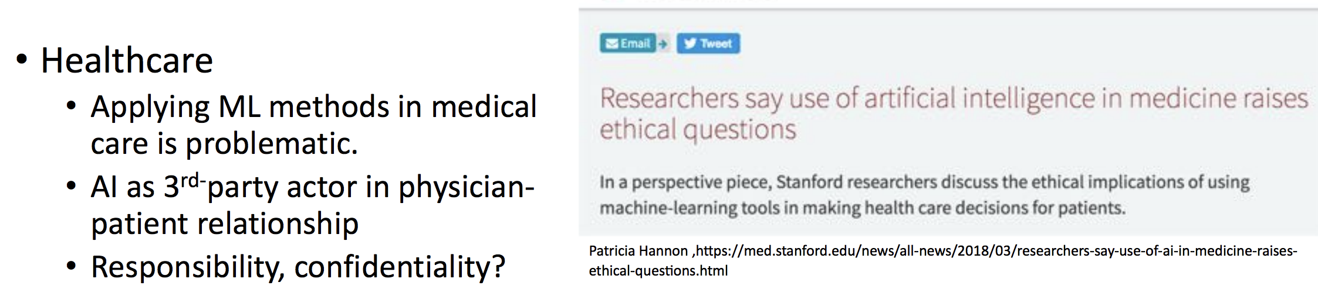
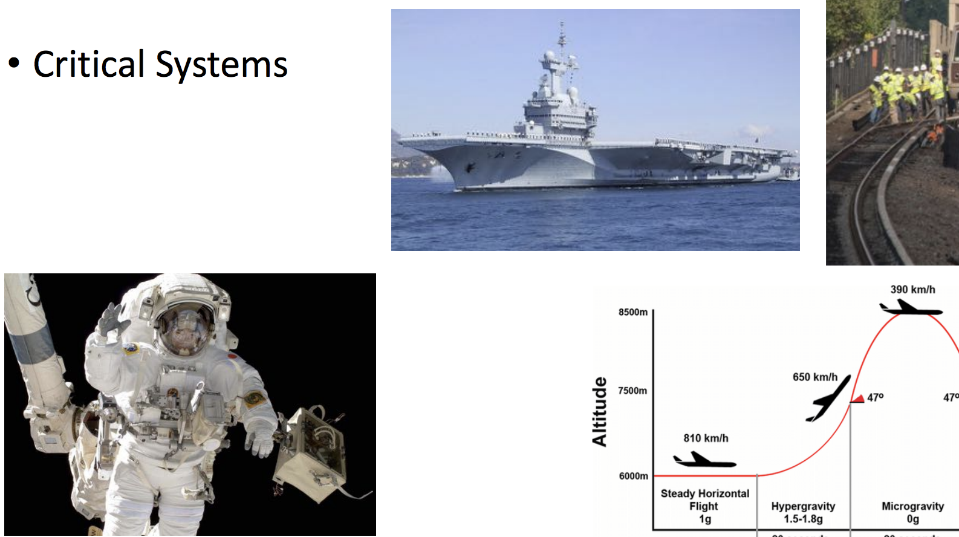
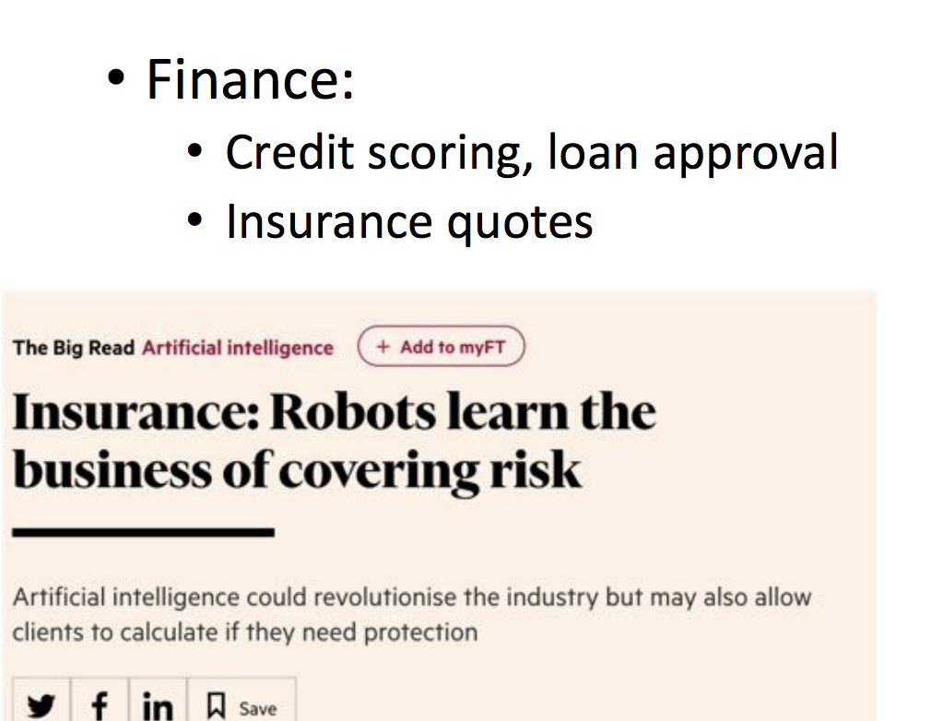
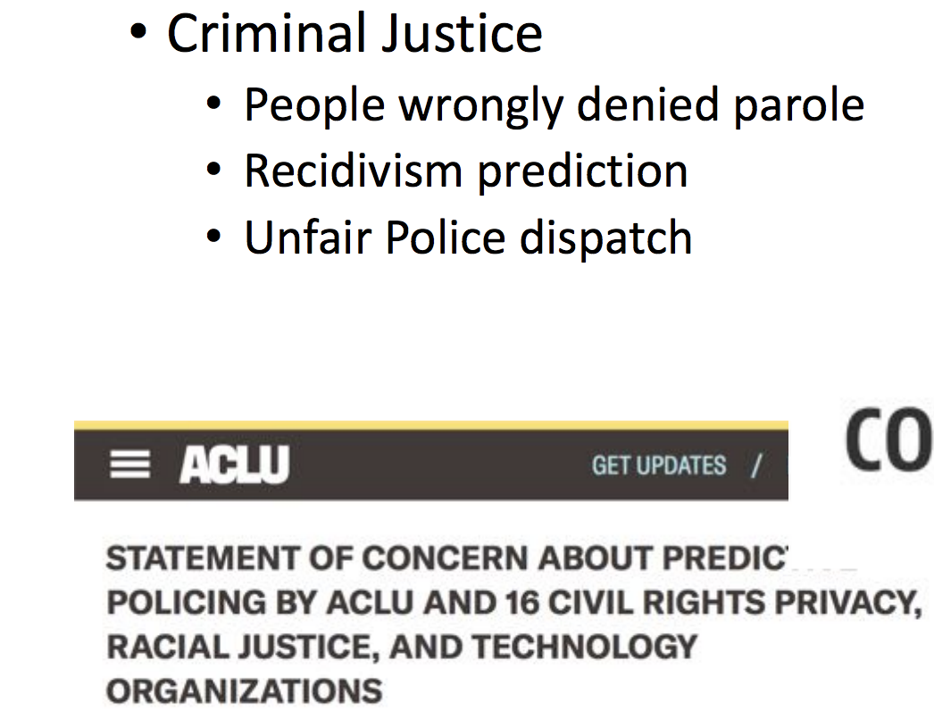
Explainable AI AAAI 2019 tutorial on Explainable AI https://xaitutorial2019.github.io/#
Shall I engineer a system that is explainable to an intelligent SME, or is it okay to build something only my fellow data scientists and engineers could understand?

Slide 19
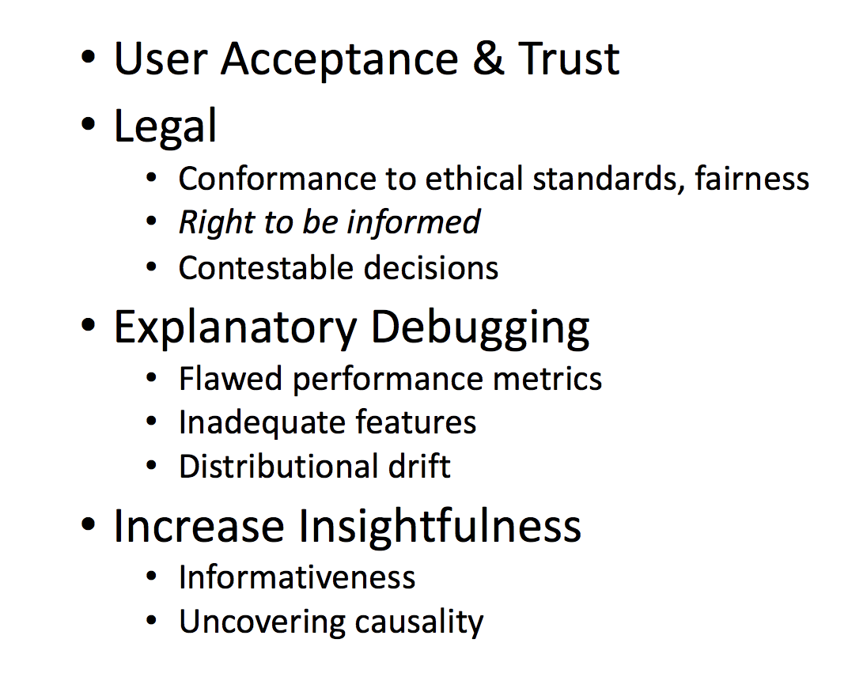
Explainable AI
The need for explainable AI:

Slide 20
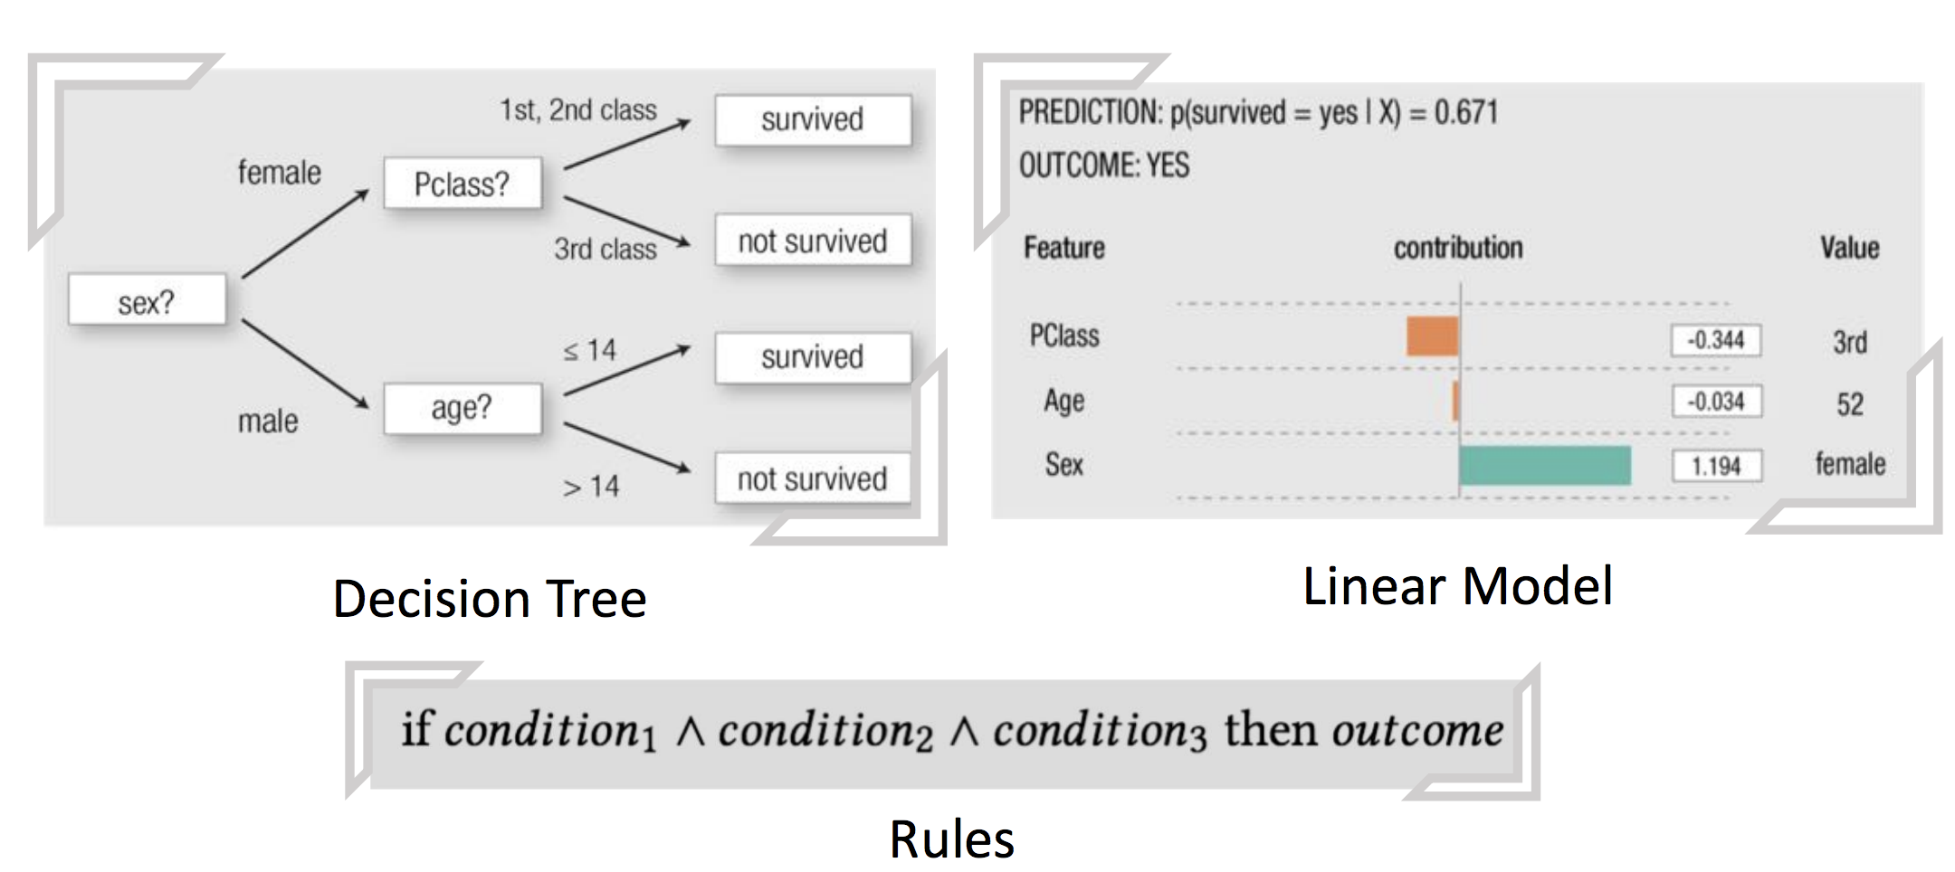
Explainable AI

Slide 21
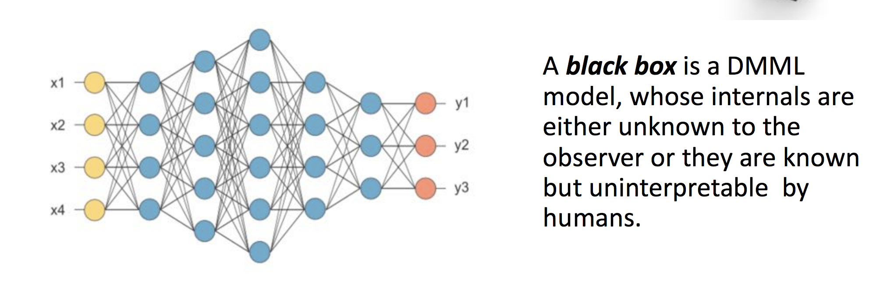
Explainable AI
DMML = data mining and machine learning

Slide 22
What did you learn today?
Questions?

